Slide 1

How to write and submit
an ISI paper?
By:
Omid Mahian(Ph.D.)
Associate Editor of J. Thermal Analysis and Calorimetry
Editor of Journal of Thermal Engineering

Slide 2
Assumptions in this workshop
1-Your research work is finished and your results are generally ready and the only remaining work is writing the article.
2. Your English level for writing technical texts is above intermediate.
3- You are sure about the innovation of your work.

Slide 3
Contents
1. Paper types
2- Structure of an article
3. How to choose the title
4. How to write the abstract
5. How to write the introduction, Materials and Methods, discussion and results and the conclusion
6. Tips for writing articles in English?
7- English edition of article and checking plagiarism
8- Writing Cover Letter, Introducing Referees, Finding the Right Journal
9. How to submit the article

Slide 4
Paper types
Research Paper (Original Paper, Full Paper)
Short Communication (Technical Note, Technical Brief)
Novelty is less than original paper

Slide 5
Paper types
Review Paper
Case Report
Some journals just accepts by invitation
Review process is easier that original papers
Some journals pay money for publishing there (for example; Int. J. Refrigeration pays 500 Euro)

Slide 6
Paper types
Correspondence (letter to editor)
Book Review
Comment

Slide 7
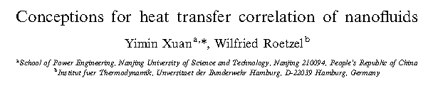
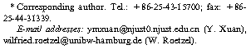
Article structure
Title: What is this?
Author(s) & Affiliation: Who wrote this?

Slide 8
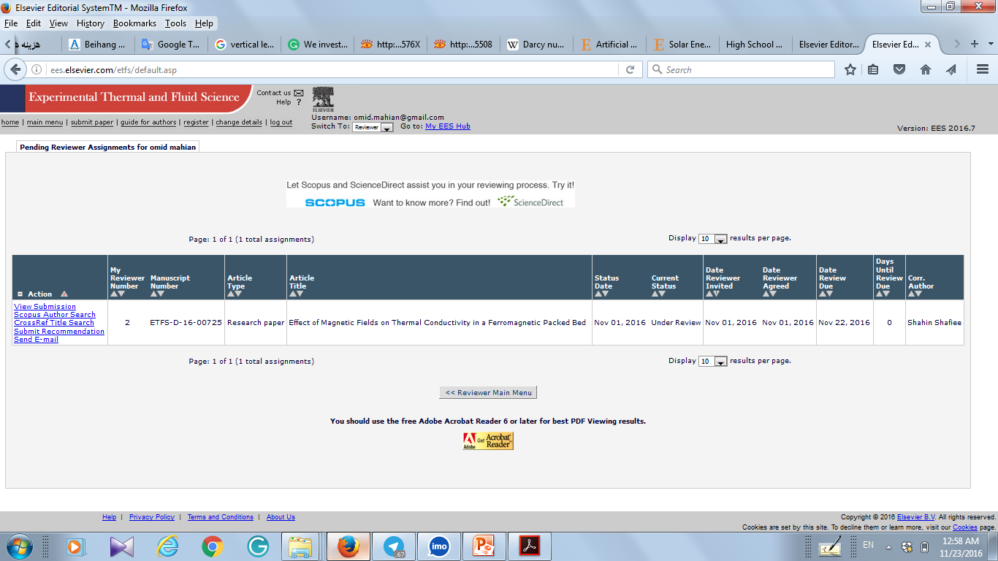
Note about corresponding author

Slide 9
Article structure
Abstract: Summary of the work
Keywords: between 3-5 words
Example: for paper on evaporation of water
Keywords: Water; evaporation; experimental study
Introduction (Literature review, Objective)
:What are we talking about?

Slide 10
Article structure
Materials(Experiments, Problem description, numerical modeling,….)
Results :What did we study?
and discussion: What are the reasons?
Conclusion: What should be remembered?
Acknowledgments: Who helped?

Slide 11
Article structure
Nomenclature
References: Whose work was referred to?
Appendices: Extra information

Slide 12
How to write title?
1- As short as possible; for example:
Effects of temperature and pressure on the efficiency of square, rectangular triangular, and circular cavities
Effects of temperature and pressure on the efficiency of cavities with various shapes

Slide 13
How to write title?
2- What is novelty? Give in title is possible
Study of flow in a channel
Study of flow in a channel using oil
3- Do not use abbreviation as much as can
Study of EG …..
Study of Ethylene Glycol…..

Slide 14
How to write title?
4- Using attractive words depends on journal
(for example this one selected for Energy field)
Experimental studies on the properties of water
Experimental studies on the properties of water for high temperature applications

Slide 15
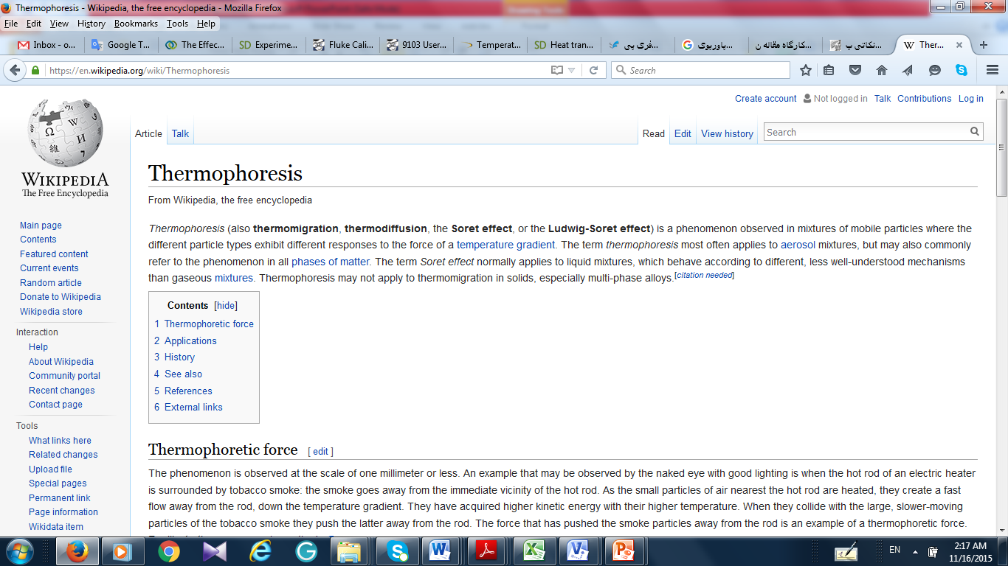
How to write the title?
5- Sometimes use similar words that were not used before:
Flow of nanofluids in a cavity considering the Thermophoresis effect
Flow of nanofluids in a cavity considering the Ludwig–Soret effect

Slide 16
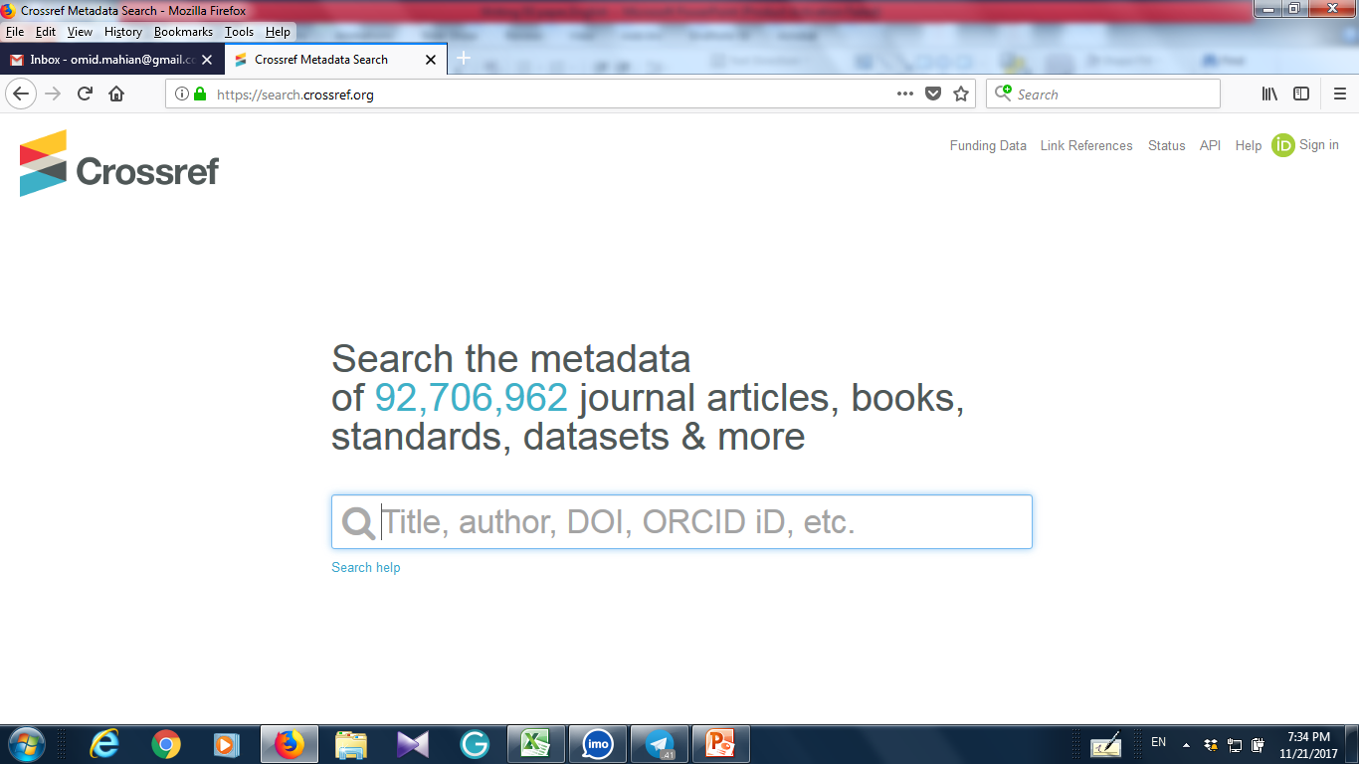
A note on selecting the title
Before finalizing your title, check its novelty by using this website; the reviewer should not find similar papers to yours at first pages:
https://search.crossref.org/

Slide 17
How to write the abstract
Abstract: One of the most important parts of the article In the abstract: Express the problem, method of doing work and part of the results The length of this section is usually between 80 and 400 words (depending on the type of journal).

Slide 18
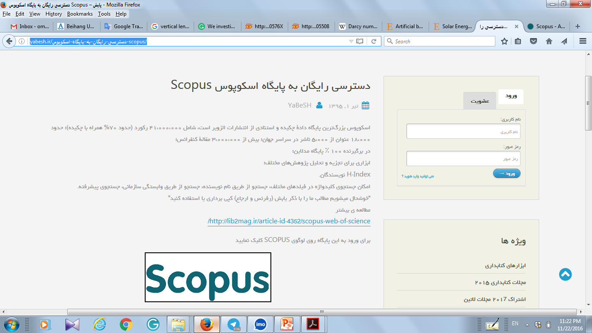

How to write introduction
Use Google Scholar or Scopus to find related papers for introduction

Slide 19
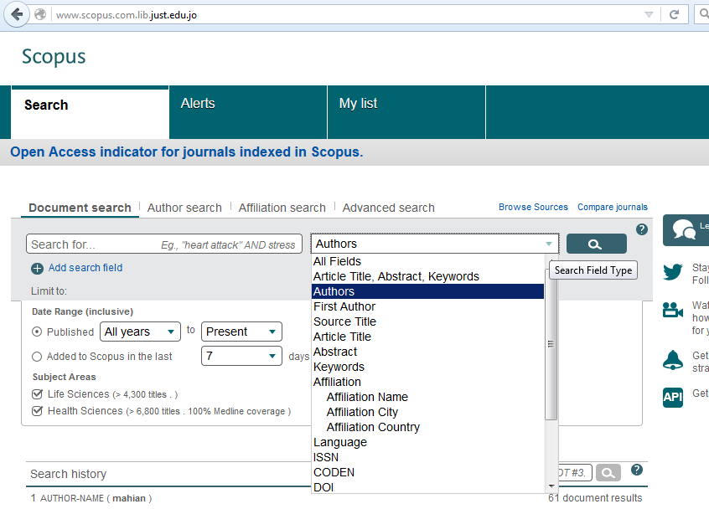

Slide 20

After searching in Scopus, if you find, for example, 100 articles, select about 20-25 related articles.
If you choose a particular journal to submit your article, select more articles from that journal.
It is important for journals that articles published in the past two or two years are used as references.

Slide 21
Choose the latest references. For example, if you find 100 articles between 2000 and 2017, you will choose newest references, but it's a good idea if you cite the first papers in the subject(2000).
Start from old to new articles

Slide 22
First sentences are about the importance of work
Extensive studies have been conducted on ....... due to its significance in industrial applications such as cooling of electronic devices, renewable energy systems, solidification processes and so on [1-3].

Slide 23
After, you start with such sentences:
Many researches have been conducted to determine the viscosity of nanofluids, both experimentally and theoretically. Here, some of the recent experimental works are briefly reviewed.
Although a comprehensive review of natural convection heat transfer in cavities using nanofluids was accomplished by Haddad et al. [2] in 2012, but, here, some of the papers in this field are reviewed briefly.
In the following, a brief review of studies conducted on natural convection flow of nanofluids is presented.

Slide 24
Notes for writing Introduction
Avoid copy and paste of sentences, even if you cite the references and the sentences are from your former articles.
It is not enough to change the verb or use synonymous words.
Summarize an article in 2-3 sentences(preferably not longer)

Slide 25
Steps for summarize a paper
1) First, copy the abstract and the conclusion from the article on your Word file.
2) Then write your understating from the abstract and conclusion in 2-3 sentences.
3) The first sentence deals with the problem and the second sentence gives the result of the desired work
4) Do not use negative sentences about other papers; maybe the authors become your reviewer.
5) To refer to the work of others, mention only their surname in the introduction, not the first name.
6) If the number of writers was more than two, then use “et al.” :
Mohammadi et al. [1]

Slide 26
Tips for writing introduction
If the introduction was long, you can use such sentences:
The details of some other works in this field are not presented here to save the space; the interested readers can refer to Refs. [20–22] on solar energy, Refs.[23-24] on nanofluids,…..
After reviewing papers, use the following terms
A review of the literature shows that there is no study on …..
Based on the best knowledge of the authors, there is no work on the….

Slide 27

Use similar sentences for last paragraph which is the most important part:
The main aim of this study is to investigate….
This paper aims to …..
In this paper, for the first time, the effects of …

Slide 28
Materials and Methods
Tips
Provide as much reference as possible for your equations, especially unusual ones.
Express the assumptions of your problem clearly.
Validation of numerical studies is necessary.

Slide 29
Materials and Methods
Answer these questions:
Did you use special software(not Excel or Word)? If Yes, so give the name.
How much is the uncertainty? How much is accuracy of measurement devices? Maybe nee to give company’ name.
How long takes your system reaches steady state?
How many times the experiments were repeated?
What are the sources of errors?
How did you calibrate your instruments?

Slide 30
How to Write Results and Discussion
In this section, first, fully describe the figures, and then explain the possible reasons for these changes.
Writing just one page discussion for an article with 7-8 Figures may lead to the rejection of the article
If you write good discussions, the chance of acceptance increases.

Slide 31
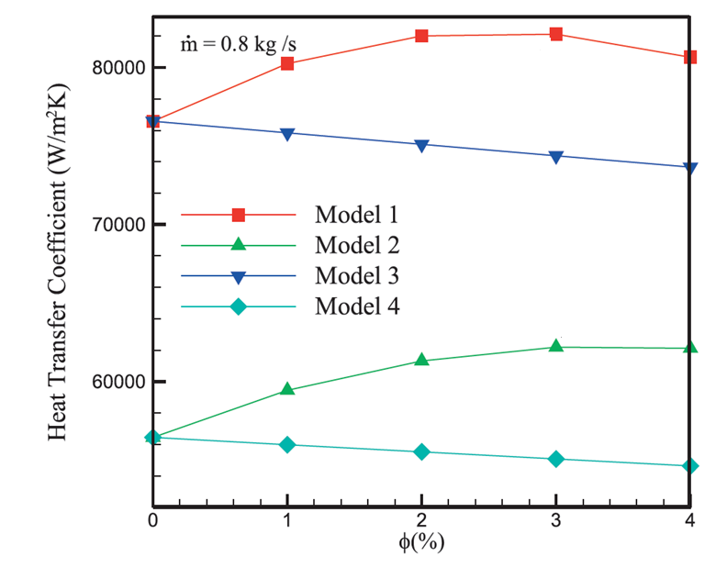
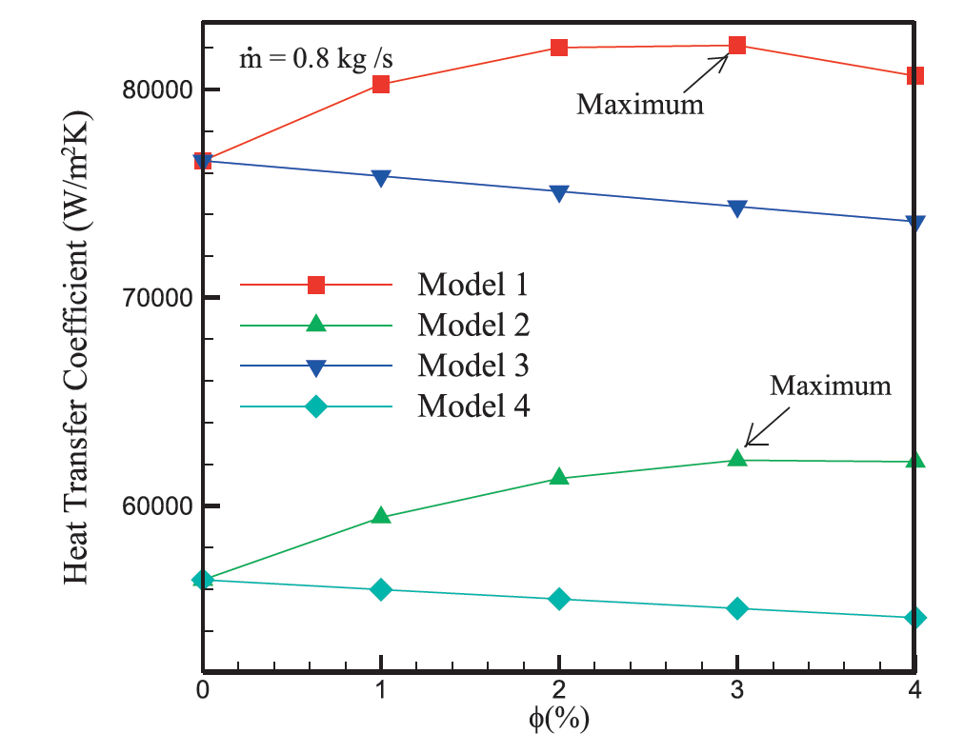
Tips to write discussion
Indicate maximum or minimum points in figures if there is any:

Slide 32
Conclusion
With 1-2 sentences explain again the problem including the novelty and method of research(experiment, numerical…)
Next, you can use sentences like the following:
The main findings of present work can be summarized as follows:
Temperature of water increases with pressure.
Water freezes at 0 C.
……

Slide 33


Slide 34
Tips for writing papers in English
Write the article from the beginning in English
You can use the Google Translate website to write sentences that you have in mind and do not know English. Although it may not give you the correct translation, you will have the idea to write.
For example:
With increasing pressure in the chamber, the water temperature increases.
Cavity

Slide 35
Tips for writing papers in English
After writing an article, check it out. But not the same day but one or two days after writing because your brain is not much ready to find errors at the same day.
If you have written a sentence and are not sure about it, search it in Google or articles of English Native.

Slide 36
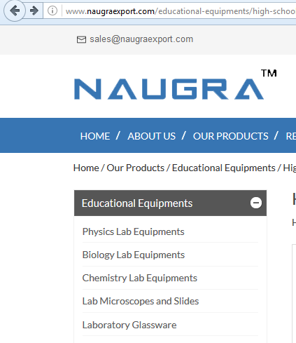
For example : Equipment
Equipment
Or
Equipments

Slide 37
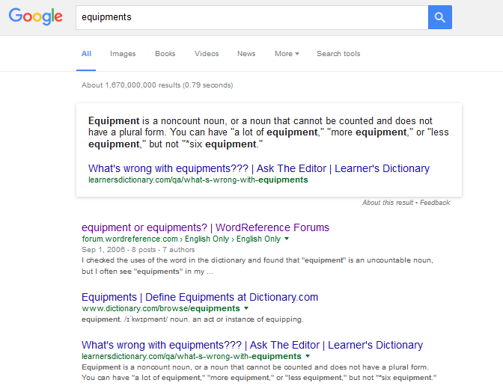


Slide 38
Some Software for English Edition
1- Word Software
2- Ginger software
3- Grammarly.com

Slide 39
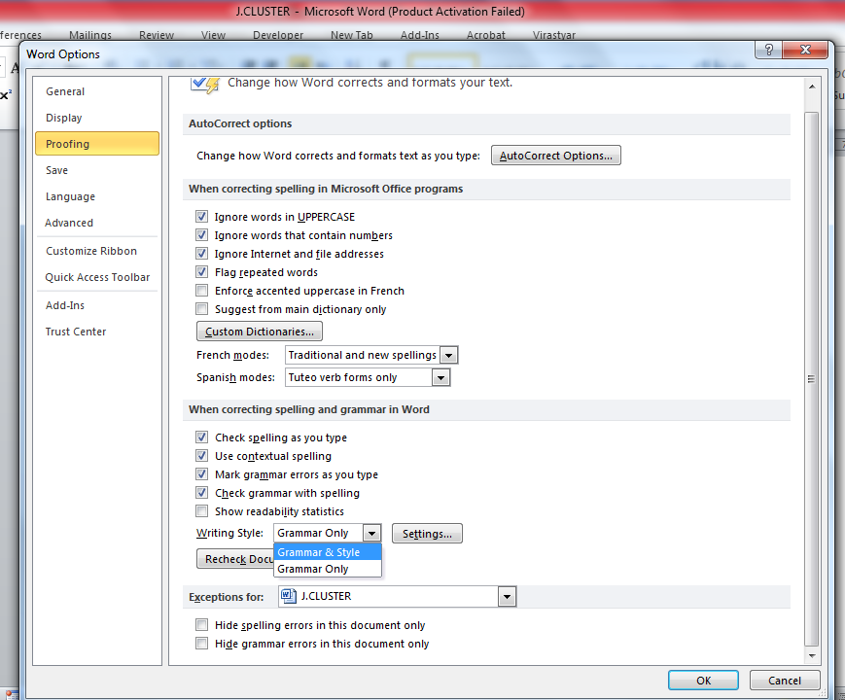
Grammar check

Slide 40
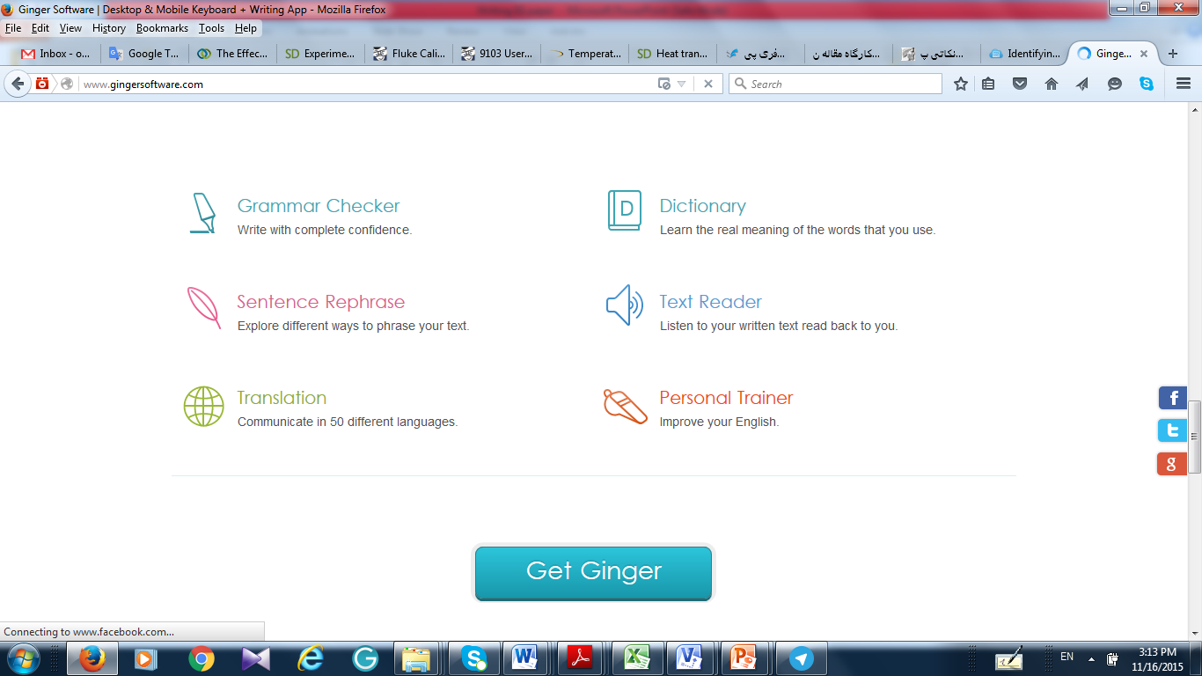
Ginger software

Slide 41
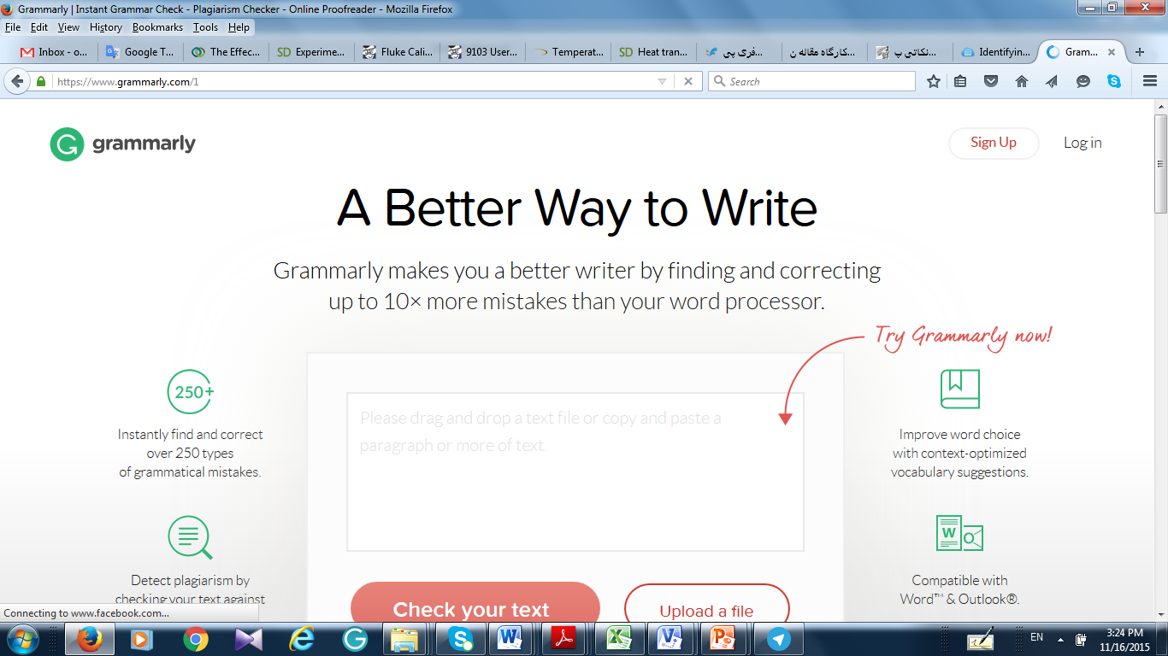

Slide 42
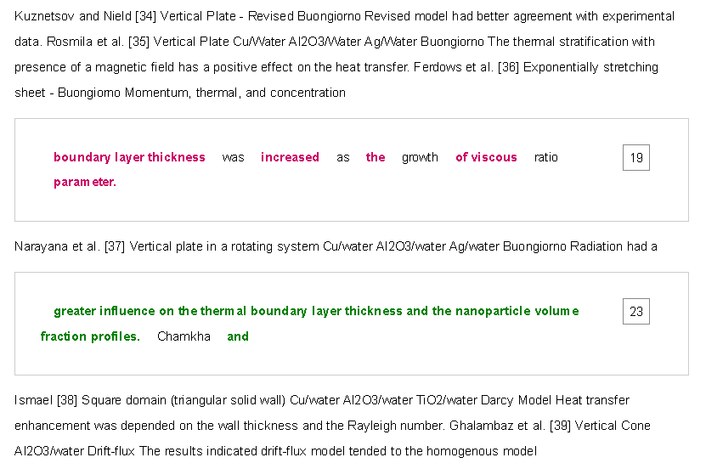
Plagiarism and Similarity
In some journals is 15%, and some other like Applied Energy 35% for research paper and 45% for review paper.

Slide 43
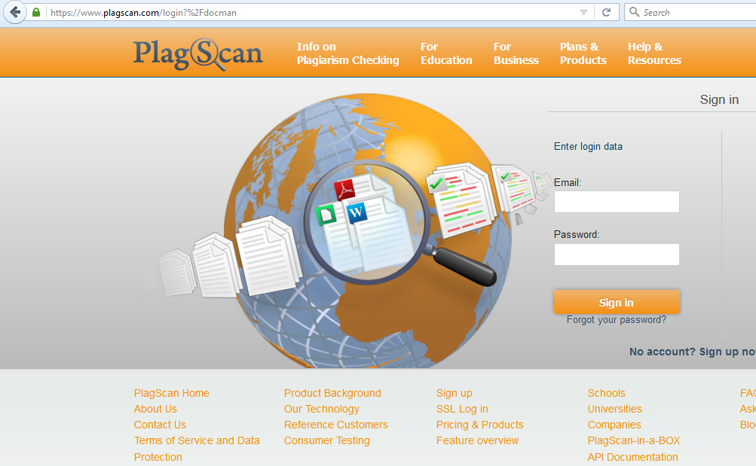


Slide 44

http://www.ithenticate.com/

Slide 45
Example of Plagiarism Outcomes( 6 months after publication)
Regarding your paper “…………..”
The AIAA Publications Ethical Standards Subcommittee (PESS) has completed its review of the ethical complaint AIAA received concerning the striking similarities between
your JTHT paper and several of your previous publications.
In response to these findings, and with the support of the PESS, I have concluded that you be banned from publishing in any AIAA journal or book for the period of two years, effective from the date of this letter.

Slide 46
Cover letter
Simple Cover letter
Dear Editor in Chief
Professor .....
I would like to submit our research paper:
........
by: .........
for possible publication in your journal:
....................................
Hereby, I would like to say that the work is original and it is not under review by other journals.
Thanks in advance for your time and attention
Your Sincerely
.......

Slide 47
Professional cover letter
Dear Editor in Chief
Professor .....
I would like to submit our research paper:
........
by: .........
for possible publication in your invaluable journal:
....................................
In this paper, for the first time, besides the effects of nanoparticle shape, the effects of tube material on the heat transfer are evaluated. Considering the effects of tube material in the present analysis shows well the key role of engineers in design and accurate selection of materials of thermal and energy devices.
I am looking forward to hear from you once you get some free time.
Your Sincerely
......

Slide 48
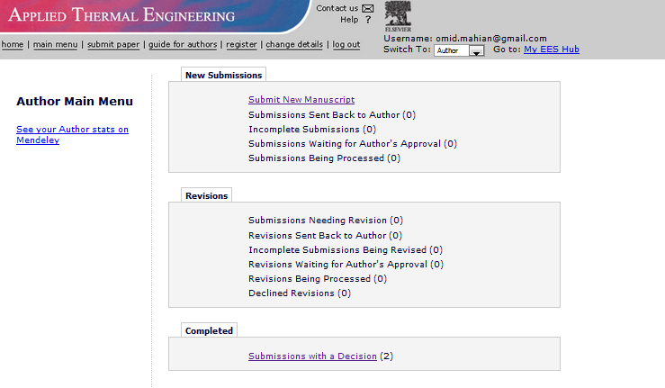
How to submit a paper

Slide 49
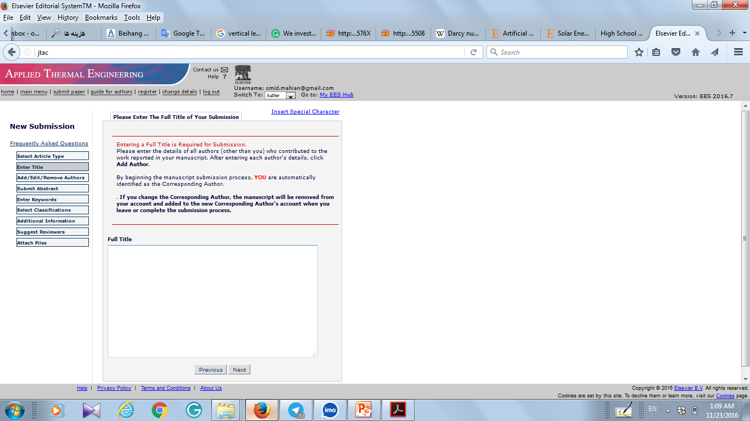

Slide 50
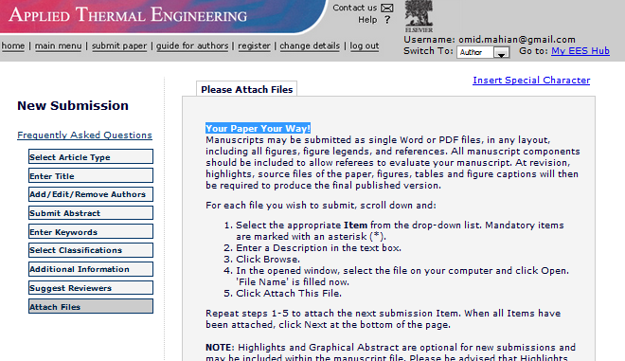
Your Paper Your Way!

Slide 51
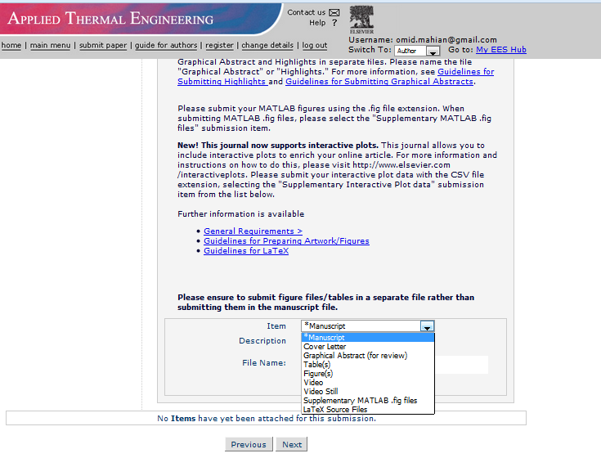

Slide 52
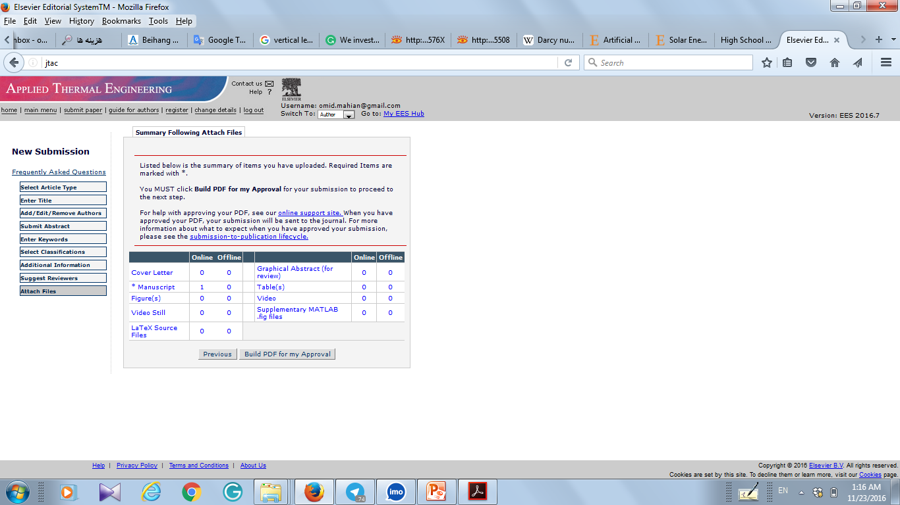

Slide 53
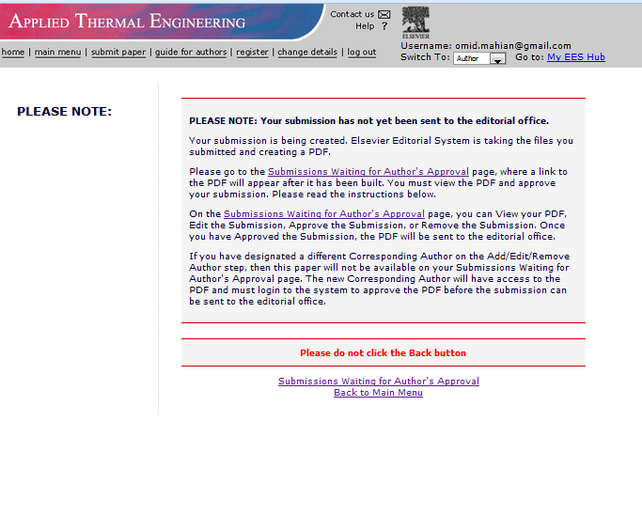
Click here

Slide 54
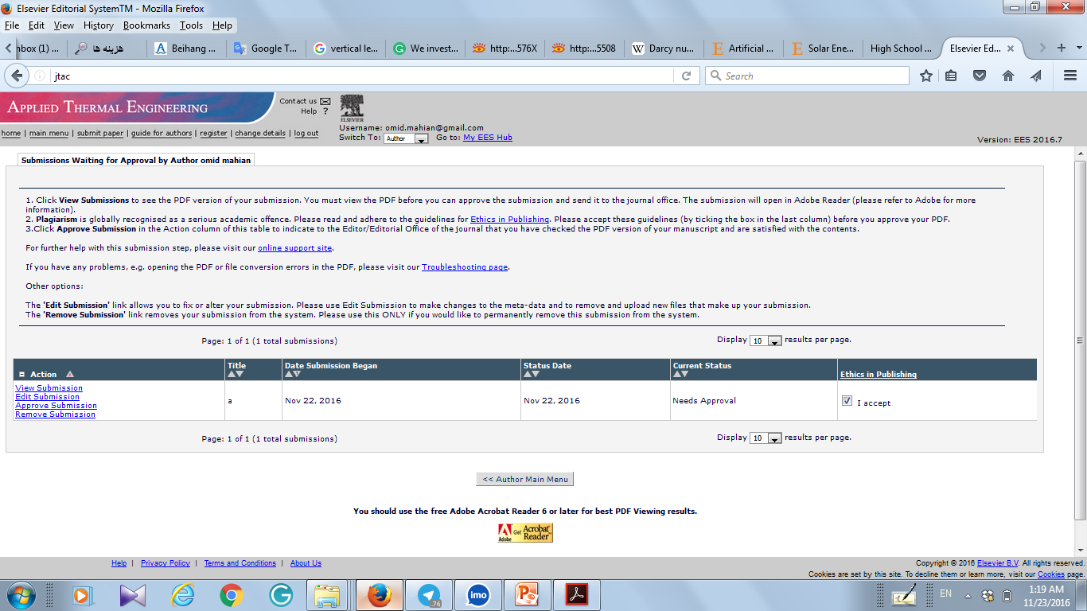
After checking PDF press Approve submission

Slide 55
How to find a journal for submission?
There are several ways to find the journal
Send the article to the journal that you cited from it more.
Use http://www.scimagojr.com and then select one of the journals. Note that some journals are not in ISI list.
The site introduces some journal selectors:
http://guides.library.duq.edu/wheretopublish

Slide 56
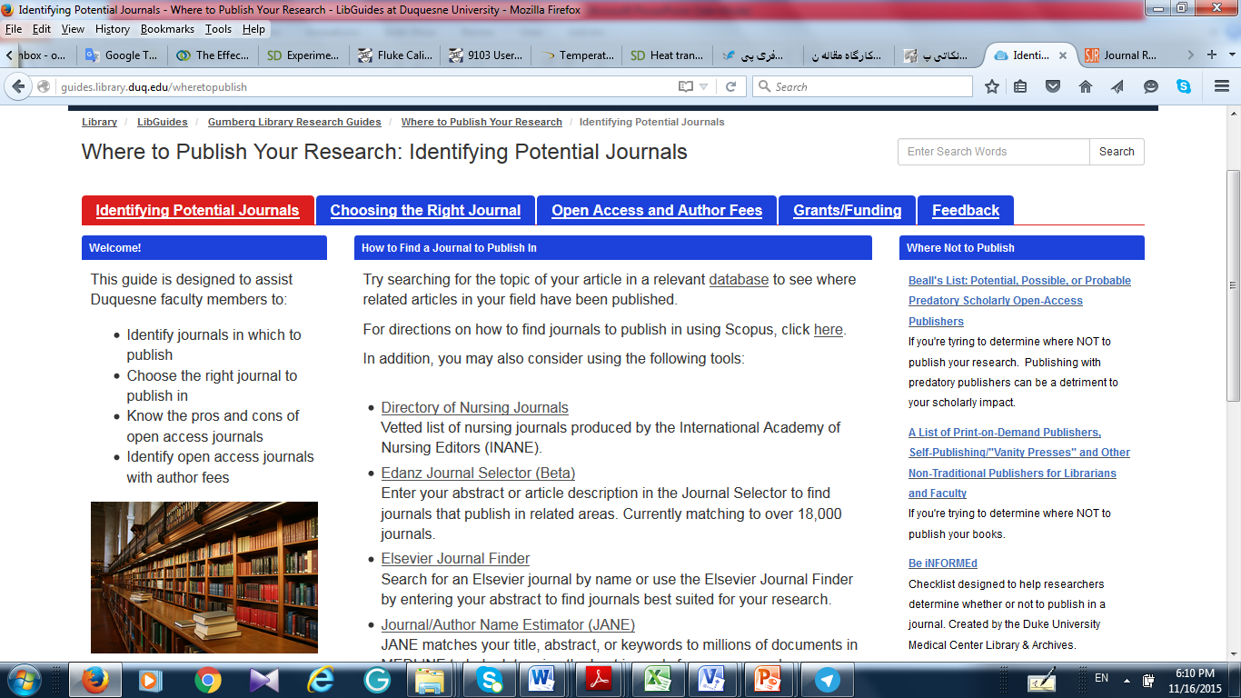

Slide 57
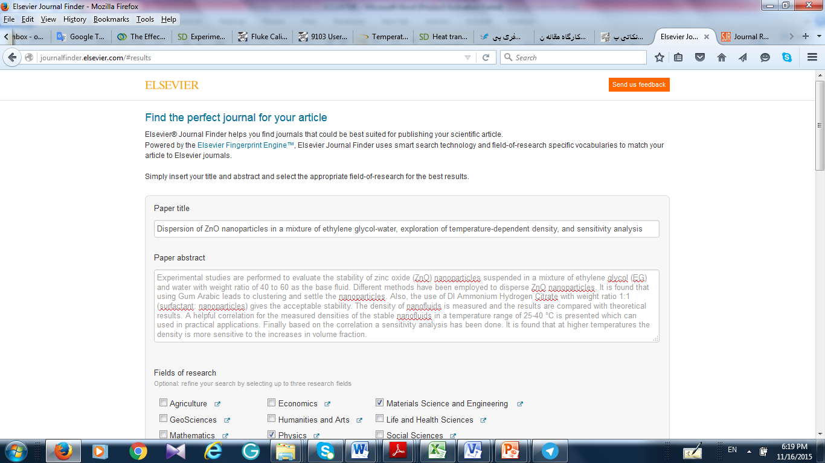

Slide 58
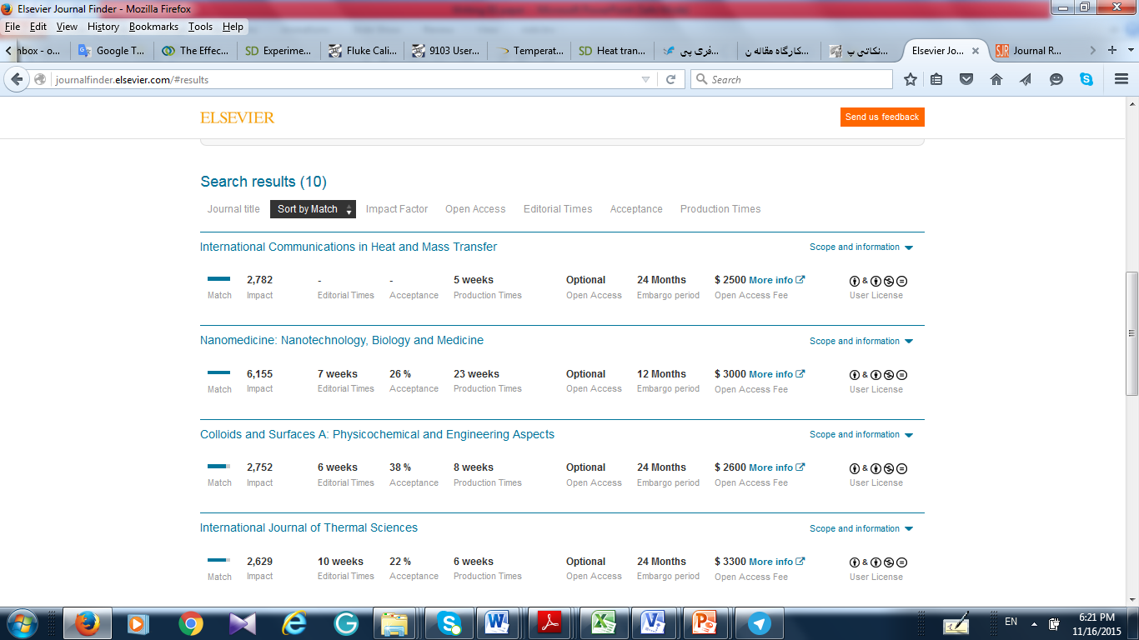

Slide 59
Suggesting Reviewers
At Least suggest 3 reviewers, if you can even suggest 5.
Suggest among young researchers and people that you cited their works in your paper.
Suggest people that publish in your field and also they published some papers in the same journal that you want to submit your work

Slide 60
The End

